Slide 1
Polygon Partitioning
Valentina Korzhova
Office ENB 323
korzhova@cse.usf.edu

Slide 2
Objectives
Triangulation algorithms
The diagonal-based triangulation algorithm
Ear-based triangulation algorithm
Complexity of the algorithms
Definition of monotone polygon
Partitioning into monotone polygons
Triangulation of a polygon in n log n time

Slide 3
Triangulation of polygons
Decompose the polygon into shapes that are easier to handle: triangles
A triangulation of a polygon P is a decomposition of P into triangles whose vertices are vertices of P. In other words, a triangulation is a maximal set of non-crossing diagonals.
diagonal

Slide 4
Diagonal-Based Tringulation
Diagonal
The segment s = v_{i}v_{j} is a diagonal of P iff
for all edges e of P that are not incident to either v_{i} and v_{j}, s and e do not intersect.
s is internal to P in the neighborhood of v_{i} and v_{j} .
5
4
1
3
2
0
Diagonalie

Slide 5
Diagonal-Based Tringulation
Algorithm: TRIANGULATION
Repeat n-3 times
for each candidate diagonal
test each of neighborhoods
output Proper diagonal

Slide 6
Brute Force Triangulation
Theorem: Every polygon P of n vertices can be partitioned into triangle by the addition of(zero or more) diagonals.
Complexity of diagonal-based algorithm:
O(n²) - # of diagonal candidates
O(n) testing each of neighborhoods
Repeating this O(n³) computation for each of the n-3 diagonals yields O(n⁴)

Slide 7
Ear Based Idea….
Locate an ear
Output diagonal
Clip the ear
Repeat until a triangle is left

Slide 8
Ear Based Idea….
Definition of Ear: Three consecutive vertices, a, b, c form an ear if ac is a diagonal
Meisters’ Two Ears Theorem: Every polygon (N ≥ 4) has at least two non-overlapping ears.
Proof: Consider a triangulation of an n-polygon, with n > 3. The triangulation consists of n-2 triangles. Since the polygon has n edges but there are only n-2 triangles, by the Pigeonhole Principle, there are at least two triangles with two polygon's edges. These are the ears
Another proof: It is known that a simple polygon can always be triangulated. Leaves in the dual-tree of the triangulated polygon correspond to ears and every tree of two or more nodes must have at least two leaves.

Slide 9
Triangulation: Implementation
Algorithm: TRIANGULATION
Initialize the ear tip status of each vertex.
while n > 3 do
Locate an ear tip v₂.
Output diagonal v₁ v₃.
Delete v₂.
Update the ear tip status of v₁ and v₃.

Slide 10
Triangulation: Implementation Analysis
Naïve Analysis
Tighter Analysis
O(n²)
Algorithm: TRIANGULATION
Initialize the ear tip status of each vertex.
while n > 3 do
Locate an ear tip v₂.
Output diagonal v₁ v₃.
Delete v₂.
Update the ear tip status of v₁ and v₃.
O(n²)
+
+
O(n)
iterations
O(n)
iterations
O(n)
iterations
O(n)
O(n)
Total: O(n³)
Total: O(n²)

Slide 11


Clipping v2…
v1
v0
v2
v3
v4

Slide 12
Example
Vertex coordinates for the polygon shown in the next slide
i | (x,y) | i | (x,y)
0 | (0,0) | 9 | (6,14)
1 | (10,7) | 10 | (10,15)
2 | (12,3) | 11 | (7,18)
3 | (20,8) | 12 | (0,16)
4 | (13,17) | 13 | (1,13)
5 | (10,12) | 14 | (3,15)
6 | (12,14) | 15 | (5,8)
7 | (14,9) | 16 | (-2,9)
8 | (8,10) | 17 | (5,5)

Slide 13
11
4
12
10
14
9
6
13
5
8
7
16
15
3
1
17
2
0

Slide 14
11
4
12
10
14
9
6
13
5
8
7
16
15
3
(1)
1
17
2
0

Slide 15
11
4
12
10
14
9
6
13
5
8
7
16
15
(2)
3
(1)
1
17
2
0

Slide 16
11
4
12
10
(3)
14
9
6
13
5
8
7
16
15
3
(1)
(2)
1
17
2
0

Slide 17
11
4
12
10
(3)
14
9
(4)
6
13
5
8
7
16
15
(2)
3
(1)
1
17
2
0

Slide 18
11
4
12
(3)
(5)
10
14
9
(4)
6
13
5
8
7
16
15
(2)
3
(1)
1
17
2
0

Slide 19
11
4
12
(5)
10
(3)
(6)
14
9
(4)
6
13
5
8
7
16
15
(2)
3
(1)
1
17
2
0

Slide 20
11
4
12
(5)
10
(3)
(6)
14
9
(4)
6
13
5
8
7
16
15
(7)
(2)
3
(1)
1
17
2
0

Slide 21
11
4
12
(5)
10
(3)
(6)
14
9
(4)
6
13
5
8
7
16
15
(8)
(2)
3
(7)
(1)
1
17
2
0

Slide 22
11
4
12
(5)
10
(3)
(6)
14
9
(4)
6
13
5
8
7
16
15
(9)
(7)
(8)
(2)
3
(1)
1
17
2
0

Slide 23
11
4
12
(3)
(5)
10
(6)
14
9
(4)
6
13
5
8
7
(10)
16
15
(9)
(8)
(2)
3
(7)
(1)
1
17
2
0

Slide 24
11
4
12
(11)
(5)
10
(3)
(6)
(4)
14
9
6
13
5
8
7
16
15
(10)
(9)
(7)
(8)
(2)
3
(1)
1
17
2
0

Slide 25
11
4
12
(11)
(6)
(5)
10
(3)
14
9
(4)
6
13
5
8
7
16
15
(12)
(10)
(9)
(8)
(2)
3
(7)
(1)
1
17
2
0

Slide 26
11
4
12
(11)
(6)
(5)
10
(3)
14
9
(4)
6
13
5
8
7
(13)
(10)
16
15
(12)
(9)
(8)
(2)
3
(7)
(1)
1
17
2
0

Slide 27
11
4
12
(11)
(6)
(5)
10
(3)
14
9
(4)
6
13
(14)
5
8
7
(13)
(10)
16
15
(12)
(9)
(8)
(2)
3
(7)
(1)
1
17
2
0

Slide 28
11
4
12
(11)
(6)
(5)
10
(3)
14
(15)
9
(4)
6
13
(14)
5
8
7
(13)
(10)
16
15
(12)
(9)
(8)
(2)
3
(7)
(1)
1
17
2
0

Slide 29
Triangulation
Output
Order | Diagonal indices | Order | Diagonal indices
1 | (17,1) | 9 | (15,3)
2 | (1,3) | 10 | (3,7)
3 | (4,6) | 11 | (11,14)
4 | (4,7) | 12 | (15,7)
5 | (9,11) | 13 | (15,8)
6 | (12,14) | 14 | (15,9)
7 | (15,17) | 15 | (9,14)
8 | (15,1) | 16

Slide 30
Monotone Partitioning
A chain is monotone with respect to a line L if every line orthogonal to L intersects the chain in at most 1 point
Polygon is monotone with respect to a line L if boundary of P can be split into 2 polygonal chains A and B such that each chain is monotone with respect to L
Monotonicity implies sorted order with respect to L
Monotone polygon can be (greedily) triangulated in O(n) time

Slide 31
Monotone Polygon
L
l’
l’
l’
l’
not monotone w.r.t. L
Monotone w.r.t. line L
l’
l’
l’
l’

Slide 32
Monotone Polygon
l’
not monotone w.r.t. any line
l

Slide 33
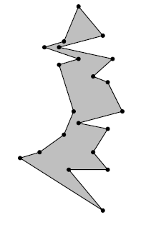
Monotone Polygon
A y-monotone polygon has a top vertex, a bottom vertex, and two y-monotone chains between top and bottom as its boundary

Slide 34
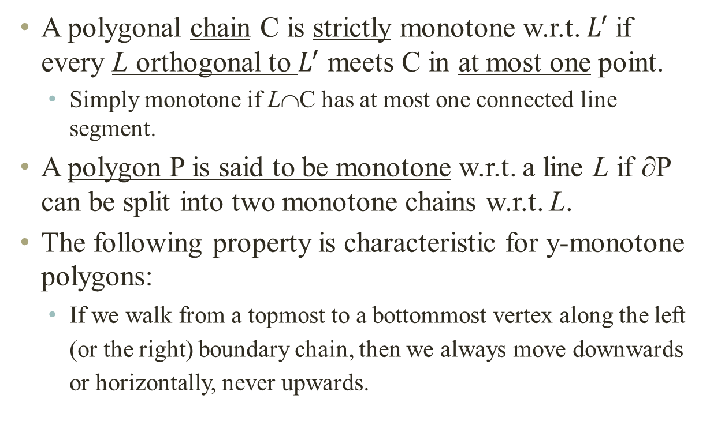
Monotone Polygon
A polygonal chain C is strictly monotone w.r.t. $L^{′}$if every L orthogonal to $L^{′}$ meets C in at most one point.
Simply monotone if L∩C has at most one connected line segment.
A polygon P is said to be monotone w.r.t. a line L if ∂P can be split into two monotone chains w.r.t. L.
The following property is characteristic for y-monotone polygons:
If we walk from a topmost to a bottommost vertex along the left (or the right) boundary chain, then we always move downwards or horizontally, never upwards.

Slide 35
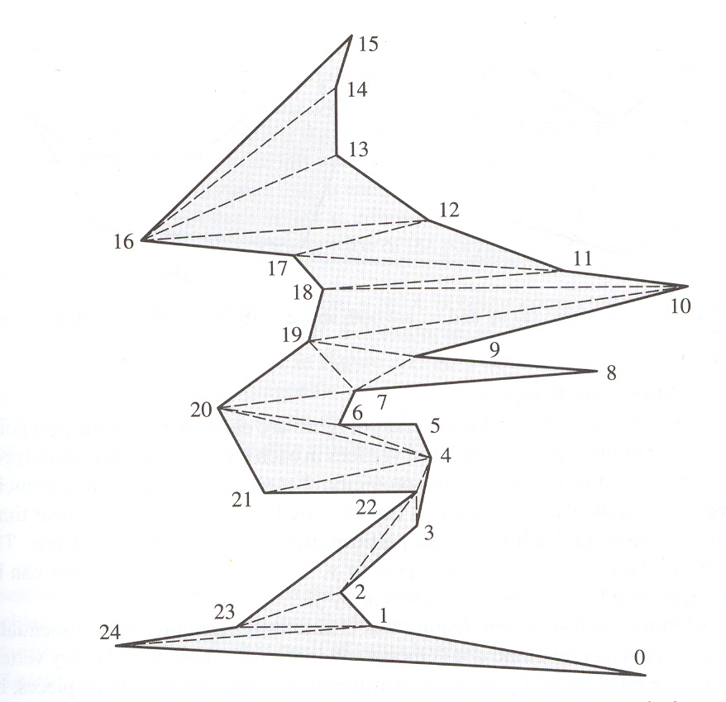
Monotone Polygon
Example of polygon that is not straightly monotone

Slide 36
Triangulation of Monotone Polygon
The algorithm to triangulate a monotone polygon depends on its monotonicity.
Developed in 1978 by Garey, Johnson, Preparata, and Tarjan, it is described in both Preparata pp. 239-241 (1985) and Laszlo pp. 128-135 (1996).
The former uses y-monotone polygons, the latter uses x-monotone.

Slide 37
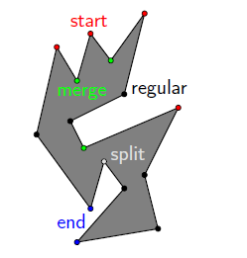
Properties of monotone polygon
If a polygon P has no interior cusps, then it is monotone
What types of vertices does a simple polygon have?
start
end
split
merge
regular

Slide 38
Properties of monotone polygon
Interior cusps
Reflex vertex whose adjacent vertices are either both at or above v, or both at or below it.
If a polygon has no interior cusps then it is monotone with respect to the vertical
Upward
Cusp (merge)
v
v
Downward cusp (split)
v

Slide 39
Properties of monotone polygon
Lemma: A polygon is y-monotone if it has neither split vertices nor merge vertices
Proof: If P is not monotone, there must exist a line l intersecting P in more than a single segment. Let [p,q] be its leftmost sub segment.
split vertex
Follow the boundary of P starting at q, where P is on the left. At some point r we must cross l.
P
If r ≠ p then the highest vertex must be a split one.

Slide 40
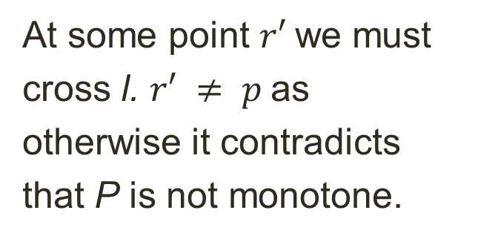
Properties of monotone polygon
If r = p we follow the boundary from q in opposite direction.
P
At some point $r′$we must cross l. $r′ ≠ p$as otherwise it contradicts that P is not monotone.
This implies that the lowest encountered vertex must be a merge one. ■
merge vertex

Slide 41
Getting Rid of Split and Merge Vertices
Sort P’s vertices from top to bottom. It takes O(nlogn) time.
Apply scan line from top to bottom to encounter vertices.
P
Diagonals are introduced at split and merge vertices.

Slide 42
Polygon Triangulation
Algorithm: POLYGON TRIANGULATION: MONOTONE PARTITION
Sort vertices by y coordinates
Perform plane sweep to construct trapezoids
Partition into monotone polygons
Triangulate each monotone polygon
P

Slide 43
Trapezoidalization
“Draw” horizontal line through each vertex
Consider only the connected segment inside the polygon containing the vertex
Two supporting vertices – top and bottom
If an “interior” supporting vertex is an interior cusp, break it
Connect downward for a upward cusp
Connect upward for an downward cusp
These connections partitions the polygon into monotone parts.

Slide 44
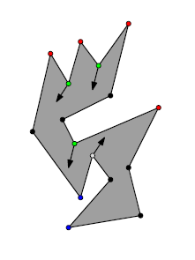
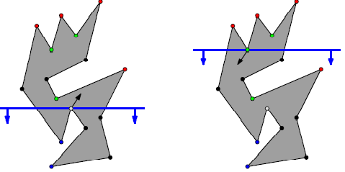
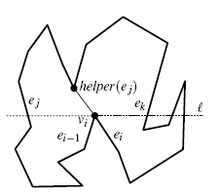
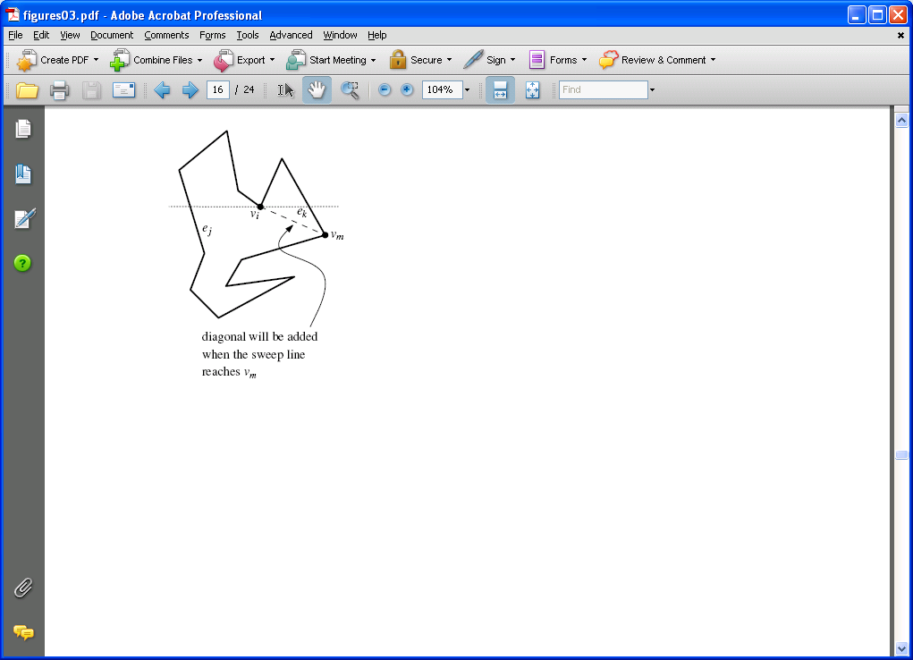
Sweep idea
Find diagonals from each merge vertex down, and from each split vertex up
A simple polygon with no split or merge vertices can have at most one start and one end vertex, so it is y-monotone

Slide 45
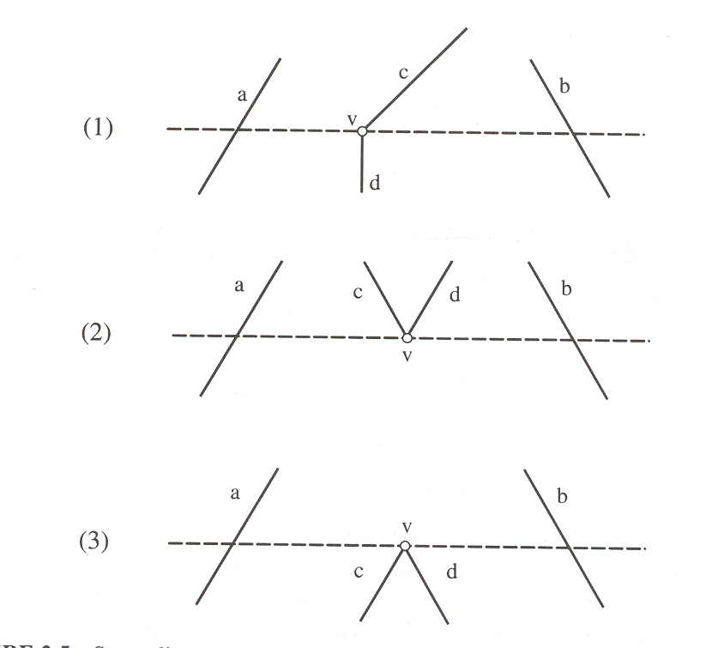
Forming trapezoids
Maintain a list of sides intersected by the sweeping line, sorted by the x-coord of intersection
At each event, update the list
Can be done in O(log N) if the list is maintained as a balanced binary tree
Overall: O(N log N)

Slide 46
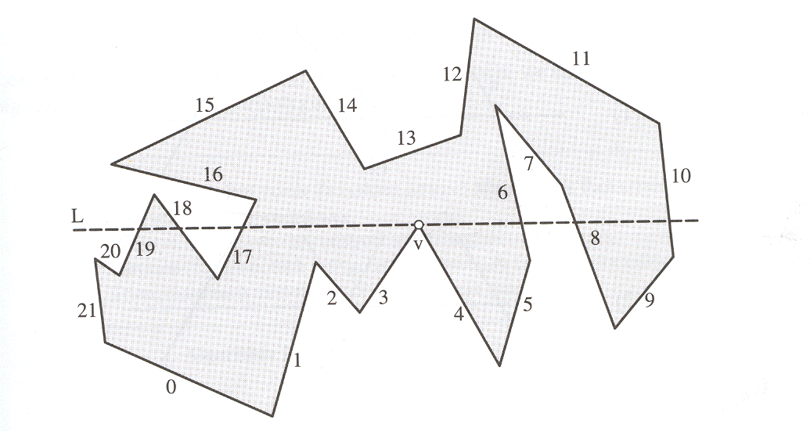
Line “Sweep”
Maintain a sorted list of intersecting sides of the polygon

Slide 47
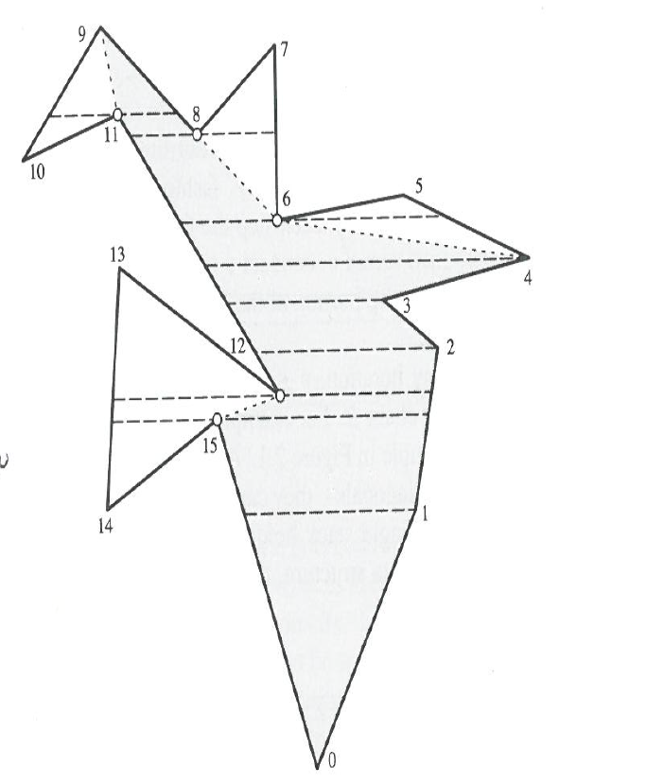
Forming trapezoids
Breaking into monotone parts

Slide 48
Triangulation of monotone polygon
Sort vertices by y-coordinate by a merge of the two chains.
Let u₁, u₂, …, u_{N} be the sorted sequence of vertices, so y(u₁) > y(u₂) > … > y(u_{N}).
Initialize reflex chain to be two top vertices.
Let v be the third highest vertex.
while v != lowest vertex do:
Case 1: v is on chain opposite reflex chain,
Draw diagonal from v to second vertex from top of chain and remove top of chain.
if chain has one element, then add v and advance v.
Case 2: v is adjacent to bottom of reflex chain.
Case 2a: v+ is strictly convex.
Draw diagonal from v to second vertex from bottom of chain and remove if chain has one element, then add v and advance v.
Case 2b: v+ is reflex or flat.
Add v to bottom of reflex chain,
Advance v.

Slide 49
Description of the processing triangulation
The algorithm processes one vertex at a time in order of decreasing y coordinate, creating diagonals of polygon P.
Each diagonal bounds a triangle, and leaves a polygon with one less side still to be triangulated

Slide 50
Description of the processing
The algorithm uses a stack to store vertices that have been visited but not yet connected with a diagonal.
The stack content is v₁, v₂, …, v_{i}, where v₁ is the bottom and v_{i} the top of the stack.
At any time during the execution, there are two invariants:
The vertices v₁, v₂, …, v_{i} on the stack from a chain on the boundary of P, where y(v₁) > y(v₂) > … > y(v_{i}).
If i ≥ 3, angle v_{j}v_{j+1}v_{j+2} ≥ π for 1 ≤ j ≤ i - 2.

Slide 51
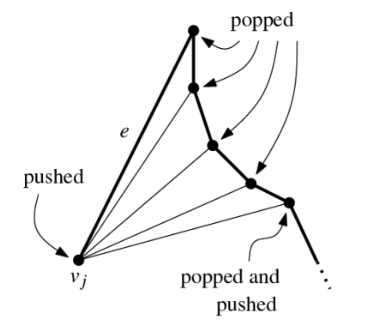
Description of the processing
Algorithm
By “adjacent” we mean connected by an edge in P.
Recall that v₁ is the bottom of the stack, v_{i} is the top.
1. Push u₁ and u₂ on the stack.
2. j = 3 /* j is index of current vertex */
3. u = u_{j}
4. Case (i): u is adjacent to v₁ but not v_{i}.
add diagonals uv₂, uv₃, …, uv_{i}.
pop v_{i}, v_{i-1}, …, v₁ from stack.
push v_{i}, u on stack.
Case (ii): u is adjacent to v_{i} but not v₁.
while i > 1 and angle uv_{i}v_{i-1} < π
add diagonal uv_{i-1}
pop v_{i} from stack
endwhile
push u
Case (iii): u adjacent to both v₁ and v_{i}.
add diagonals uv₂, uv₃, …, uv_{i-1}.
exit
5. j = j + 1
Go to step 3.

Slide 52

Constrained triangulation
Case (i): u is adjacent to $v_{1}$ but not $v_{i}$
Case (ii): u is adjacent to v_{i} but not v₁.
Case (iii): u adjacent to both v₁ and v_{i}
v₁
v₂
v₃
v₄ = v_{i} top of stack
u
v₁
v₂
v₃
v₄
v₅ = v_{i} top of stack
u
v₁
v₂
v₃
v₄ = v_{i} top of stack
u

Slide 53
Constrained triangulation
Example
v₁
v₁
v₂
v₂
u
v₃
u
1, initial
2, Case (ii)
v₁
v₂
v₃
v₄
v₁
u
v₂
u
3, Case (ii)
4, Case (i)

Slide 54
Constrained triangulation
Example
v₁
v₁
v₂
v₂
u
v₃
u
5, Case (ii)
6, Case (ii)
v₁
v₁
v₂
v₃
v₄
u
v₂
7, Case (ii)
8, Case (ii)
u

Slide 55
Constrained triangulation
Example
10, final

Slide 56
Constrained triangulation

Slide 57
Analysis of triangulating a monotone polygon
The initial sort (merge) requires O(N) time.
Each of the N vertices is visited and placed on the stack exactly once, except when the while fails in case (ii).
This happens at most once per vertex, so that time can be charged to the current vertex.
⇒ The algorithm requires O(N) time to triangulate a monotone polygon, where N is the number of vertices of the polygon.

Slide 58
Analysis of Triangulation of Simple Polygon
Sort vertices by y coordinates
O(N log N)
Perform plane sweep to construct trapezoids
O(N log N)
Partition into monotone polygons
O(N)
Triangulate each monotone polygon
O(N)
Overall: O(N log N)
N is the number of vertices of the polygon

Slide 59
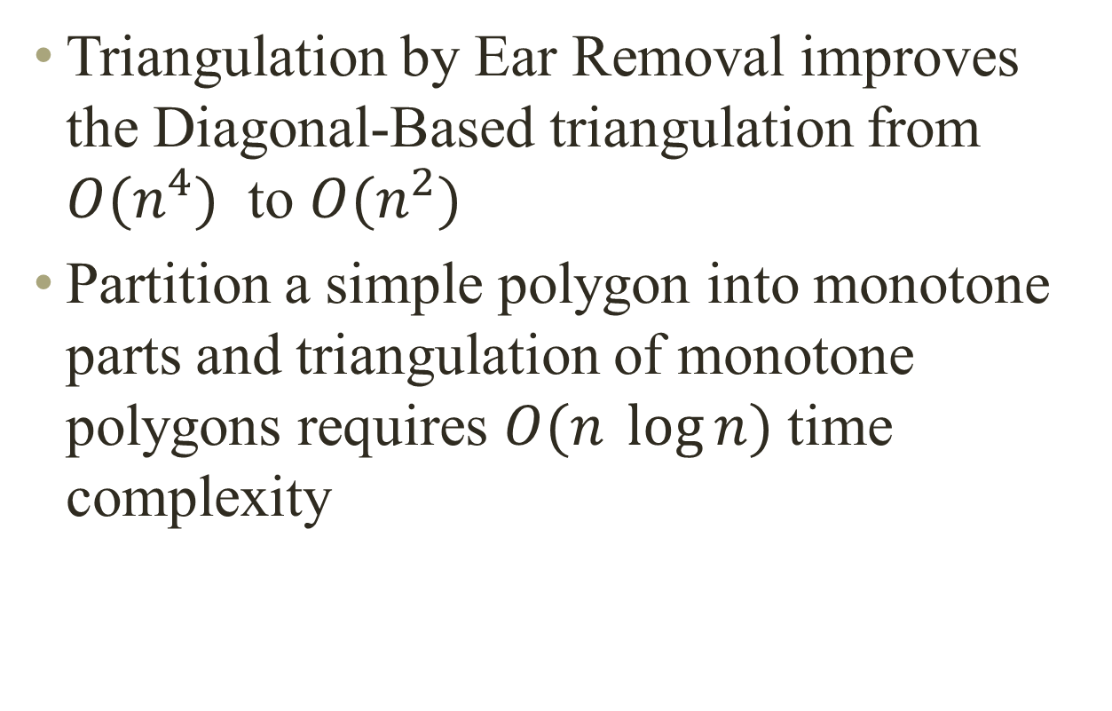
Summary
Triangulation by Ear Removal improves the Diagonal-Based triangulation from $O(n^{4})$ to $O(n^{2})$
Partition a simple polygon into monotone parts and triangulation of monotone polygons requires $O(n \log{n)}$ time complexity

Slide 60
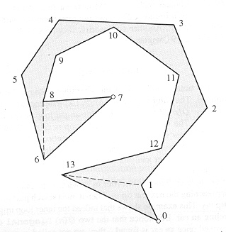
Questions
Polygon triangulation
Triangulate the following polygon using triangulation by Ear removal.
How many complete circulation of the boundary will be done before completion?

Slide 61
Questions
Monotone polygon
Is the following polygon monotone?
Triangulate the above polygon and output the diagonals in the correct order

Slide 62
Triangulation: Implementation Diagonals (Internal or External)
/*---------------------------------------------------------------------
Returns TRUE iff (a,b) is a proper internal *or* external
diagonal of P, *ignoring edges incident to a and b*.
---------------------------------------------------------------------*/
bool Diagonalie( tVertex a, tVertex b ) {
tVertex c, c1;
/* For each edge (c,c1) of P */
c = vertices;
do { c1 = c->next; /* Skip edges incident to a or b */
if ( ( c != a ) && ( c1 != a ) && ( c != b ) && ( c1 != b )
&& Intersect( a->v, b->v, c->v, c1->v ) )
return FALSE;
c = c->next;
} while ( c != vertices );
return TRUE;
}

Slide 63
Triangulation: Implementation InCone
/*---------------------------------------------------------------------
Returns TRUE iff the diagonal (a,b) is strictly internal to the
polygon in the neighborhood of the a endpoint.
---------------------------------------------------------------------*/
bool InCone( tVertex a, tVertex b ) {
tVertex a0,a1; /* a0,a,a1 are consecutive vertices. */
a1 = a->next;
a0 = a->prev;
/* If a is a convex vertex ... */
if( LeftOn( a->v, a1->v, a0->v ) )
return Left( a->v, b->v, a0->v ) && Left( b->v, a->v, a1->v );
/* Else a is reflex: */
return !( LeftOn( a->v, b->v, a1->v ) && LeftOn( b->v, a->v, a0->v ) );
}

Slide 64
Triangulation: Implementation EarInit
/*---------------------------------------------------------------------
Initialize the Boolean flag v-> ear that is part of the vertex structure.
This is accomplished by one call to Diagonal per vertex
---------------------------------------------------------------------*/
void EarInit( void) {
tVertex v0,v1,v2; /* v0,v1,v2 are consecutive vertices. */
/* Initialize v1->ear for al vertices*/
do {
v2 = v1->next;
v0 = v1->prev;
v1->ear = Diagonal(v0,v2);
v1=v1->next;
} while (v1 != vertices);

Slide 65
Triangulation: Implementation
/* Prints out n-3 diagonals (as pairs of integer indices) which form a triangulation of P*/
void Triangulate( void ){
tVertex v0, v1, v2, v3, v4; /* five consecutive vertices */
int n = nvertices; /* number of vertices; shrinks to 3. */
EarInit();
while ( n > 3 ) { /* Inner loop searches for an ear and removes it. */
v2 = vertices;
do { if (v2->ear) { /* Ear found. */
v3 = v2->next; v4 = v3->next; v1 = v2->prev; v0 = v1->prev;
PrintDiagonal( v1, v3 );
v1->ear = Diagonal( v0, v3 ); v3->ear = Diagonal( v1, v4 );
v1->next = v3; v3->prev = v1; /* Update earity. */
vertices = v3; /* In case the head was v2. */
n--;
break; /* out of inner loop; resume outer loop */
} /* end if ear found */
v2 = v2->next;
} while ( v2 != vertices );
} /* end outer while loop */
} /* end Triangulate */

